Slide 1
Data Mining and Machine Learning II
Chapter 2 – Data Preparation and Analysis

Slide 2
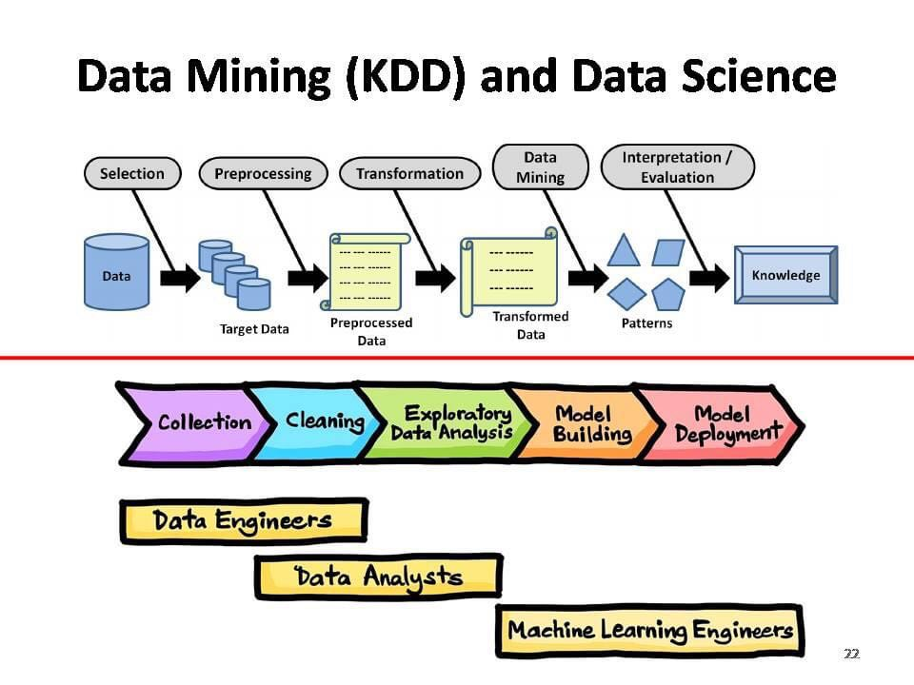

Slide 3
Data representation
Record
Relational records
Data matrix, e.g., numerical matrix, crosstabs
Document data: text documents: term-frequency vector
Transaction data
Graph and network
World Wide Web
Social or information networks
Molecular Structures
Ordered
Video data: sequence of images
Temporal data: time-series
Sequential Data: transaction sequences
Genetic sequence data
Spatial, image and multimedia:
Spatial data: maps
Image data
Video data

Slide 4
Data: Raw Data
Definition
Raw data (sometimes called source data, atomic data, or primary data) is data that has not been processed for use.
Datasets on Internet are benchmark (standard, pre-processed):
UCI Repository: https://archive.ics.uci.edu/
Kaggle: https://www.kaggle.com/datasets
Data Gov: https://data.gov/
Etc.

Slide 5
Data
Numerical data:
Measurement: temperature, weight, height, volume, etc.
Count: age, number of pages/book, population, RGB, etc.
Categorical (Nominal) data:
Day, month, year
Sex: female, male
Name, label, color, etc.
Binary data: 0 and 1, True or False.

Slide 6

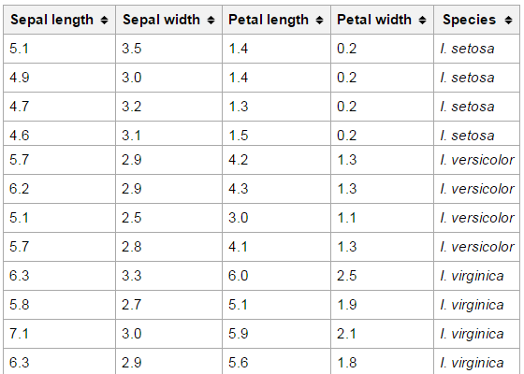

Data

Slide 7
Data
What else can be data?
Any measurement: weight, height, size, volume, etc.
Color: histogram, texture, RGB, etc.
Textual information: Shape, figure, title, description, etc.

Slide 8
Data
Qualitative Data
Qualitative data deals with descriptions (categorical data).
Data can be observed but not measured.
Colors, textures, smells, tastes, name, sex, etc.
Qualitative -> Quality
Quantitative Data
Quantitative data deals with numbers (numerical data).
Data can be measured.
Length, height, area, weight, speed, time, temperature, humidity, etc.
Quantitative -> Quantity

Slide 9
Data
Continuous Data
Measurements are continuous.
Continuous data is measured.
Continuous Data can take any value within a range.
Example: the weight of a person, temperature, travel distance, etc.
Discrete Data
Counts are discrete.
Discrete data is counted.
Discrete data can only take certain values.
Example: the number of students in the class, room names, etc.

Slide 10
Data
How to represent complex data?
Image: Vector space, histogram, feature selection, etc.
Text: word2vec, bag of word, etc.
Graph: spectral clustering
Depending on the data nature, data pre-processing algorithms are available.

Slide 11
Data: Raw Data
When do you process raw data?
Data are collected from many sources, formats, or representations.
Images in black/white, colors, grayscale, and etc.
Different resolutions.
Data attributes may be missing or noised.
Data may have wrong values caused by collecting devices.
GPS devices.
Sensor devices.
Etc.

Slide 12
Data: Raw Data
Prepare data to better process them but how do you process raw data?
Data Cleaning: fix or remove incorrect, corrupted, incorrectly formatted, duplicate, or incomplete data within a dataset.
Data Transformation: the process of converting, cleansing, and structuring data into a usable format
Data Integration: the process of combining data from different sources into a single, unified view.
Data Reduction: reduce data in term of the processing numbers or dimensions.

Slide 13
Data: Raw Data
Software solution: Data Lake, Data Warehouse for ELT (Extract, Load, and Transform)
Power BI (Microsoft)
SnowFlake
Azure (Amazon)
Hevo

Slide 14
Data Pre-processing
Data Cleaning: Lots of potentially incorrect data: duplicate, incomplete, inconsistent, missing, and more.
instrument faulty, human or computer error, transmission error
certain data may not be considered important at the time of entry
not register history or changes of the data

Slide 15
Data Pre-processing
Data Cleaning:
GPS data: real-time tracking system
Hanoi location: latitude is 21.028511, and the longitude is 105.804817;
Suddenly, a location data captured by a sensor : (20.865139, 106.683830) Hai Phong;
Customer database:
K-core algorithm is applied to keep only “relevant” customers
https://jmcauley.ucsd.edu/data/amazon/

Slide 16
Data Pre-processing
Data Transformation:
Transformation into another representation
Text to Vector or Graph (NLP course)
Image to Vector (Image Processing)
Graph to Vector, Matrix (ADS and Graph Theory)
Normalization
Discretization
Analog to Digital (Signal Processing)

Slide 17
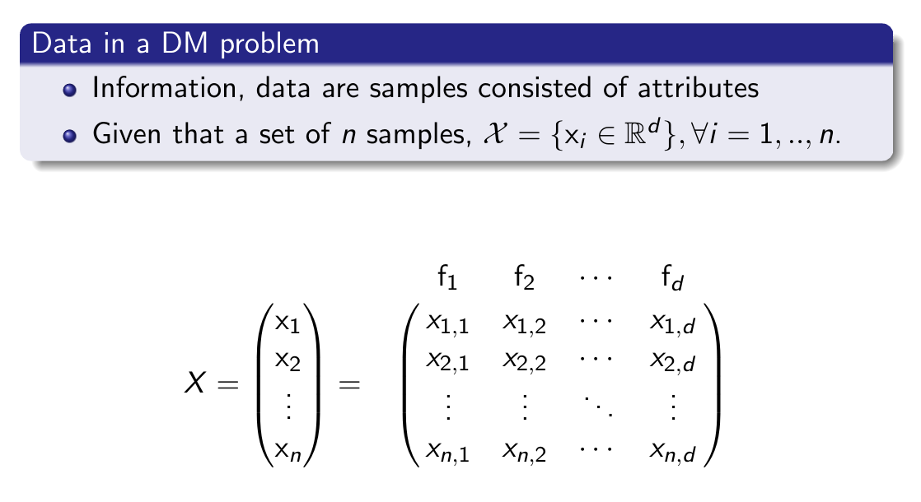
Data Vector

Slide 18
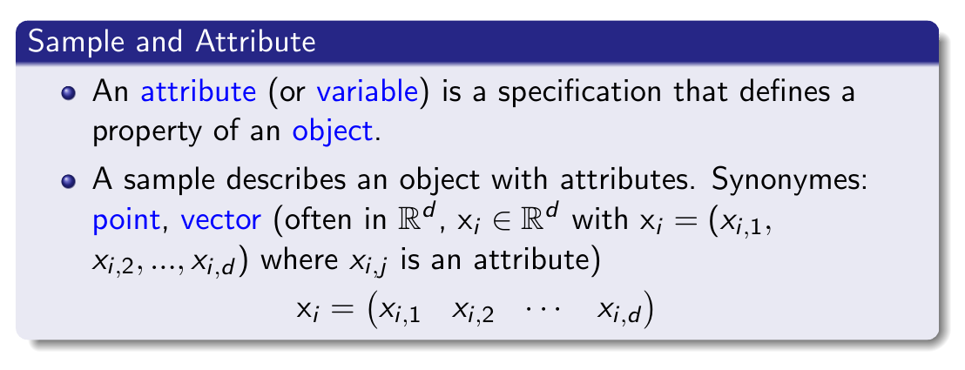
Data Vector

Slide 19
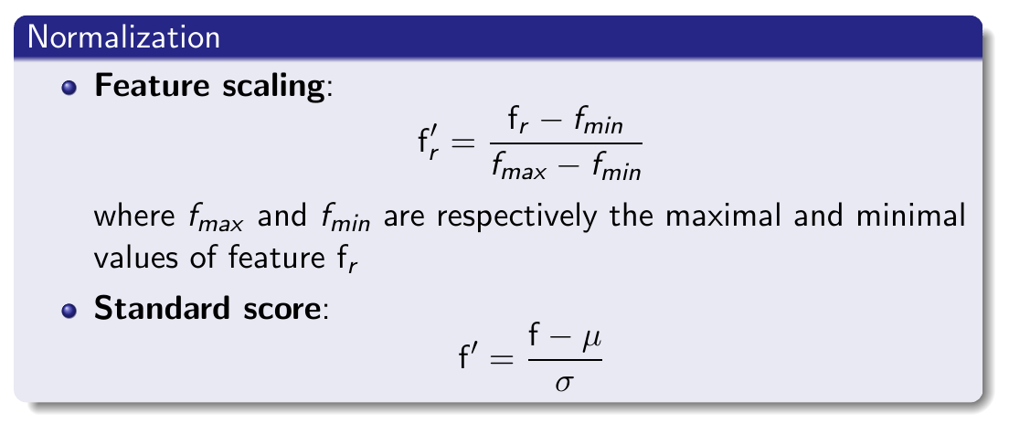
Data Normalization

Slide 20
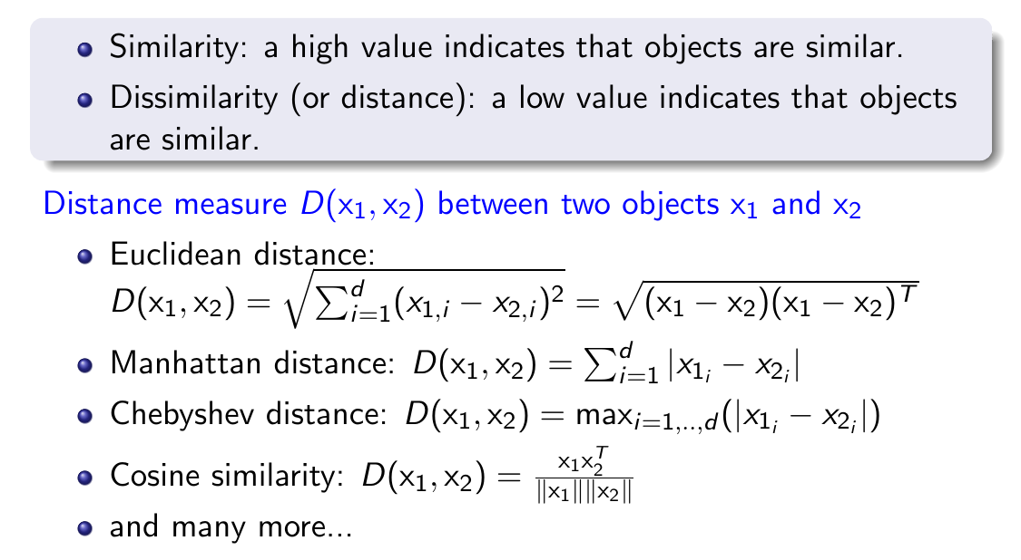
Data Similarity

Slide 21
Conclusion
Data Preparation is a fundamental task
derive the greatest possible value from the data
avoid enormous waste of time and effort later.
Data Pre-processing can provide greater efficiency, flexibility and productivity.

